Slide 1
PrivKV: Local Differential Privacy for Key-Value Structured Data
Wasfi Momen

Slide 2
Overview
Background/Related Work
PrivKV goals
Basic Concepts

Slide 3
Background/Related Work
No work done to protect privacy in key-valued databases. Keys and values are separated before perturbed.
Most algorithms use separate algorithms for each type of numerical, categorical, or set-valued data.

Slide 4
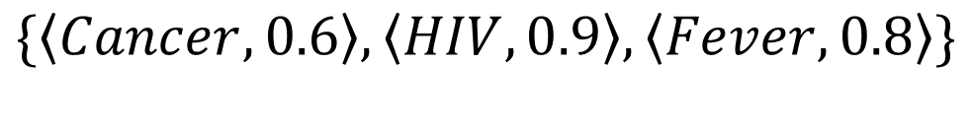
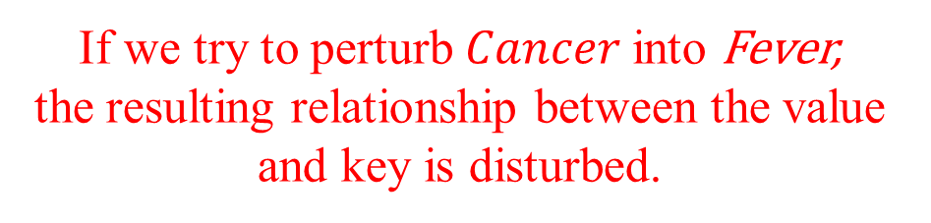
Background/Related Work
No work done to protect privacy in key-valued databases. Keys and values are separated before perturbed.
Most algorithms use separate algorithms for each type of numerical, categorical, or set-valued data.
$$\{\left\langle Cancer, 0.6\right\rangle , \left\langle HIV, 0.9\right\rangle ,\left\langle Fever, 0.8\right\rangle \}$$
If we try to perturb $Cancer$into Fever,
the resulting relationship between the value and key is disturbed.

Slide 5
PrivKV goals
Provide a “privacy-preserving key-value data collection for frequency and mean estimation in local setting” with an untrusted data collector/maintainer/publisher.
Use a lot of prior research to provide a new protocol.
[5] R. Bassily and A. Smith. Local, private, efficient protocols for succinct histograms. In STOC, pages 127–135. ACM, 2015.
[6] R. Bassily, U. Stemmer, A. G. Thakurta, et al. Practical locally private heavy hitters. In NIPS, pages 2285–2293, 2017.
[31] T. T. Nguyˆen, X. Xiao, Y. Yang, S. C. Hui, H. Shin, and J. Shin. Collecting and analyzing data from smart device users with local differential privacy. arXiv:1606.05053, 2016
[41] Y. Wang, X. Wu, and D. Hu. Using randomized response for differential privacy preserving data collection. In EDBT/ICDT Workshops, 2016
[42] S. L. Warner. Randomized response: A survey technique for eliminating evasive answer bias. Journal of the American Statistical Association ,60(309):63–69, 1965
…and many more
Also provide options for iterative optimization (PrivKVM) and for iterative cost analysis (PrivKVM⁺)

Slide 6
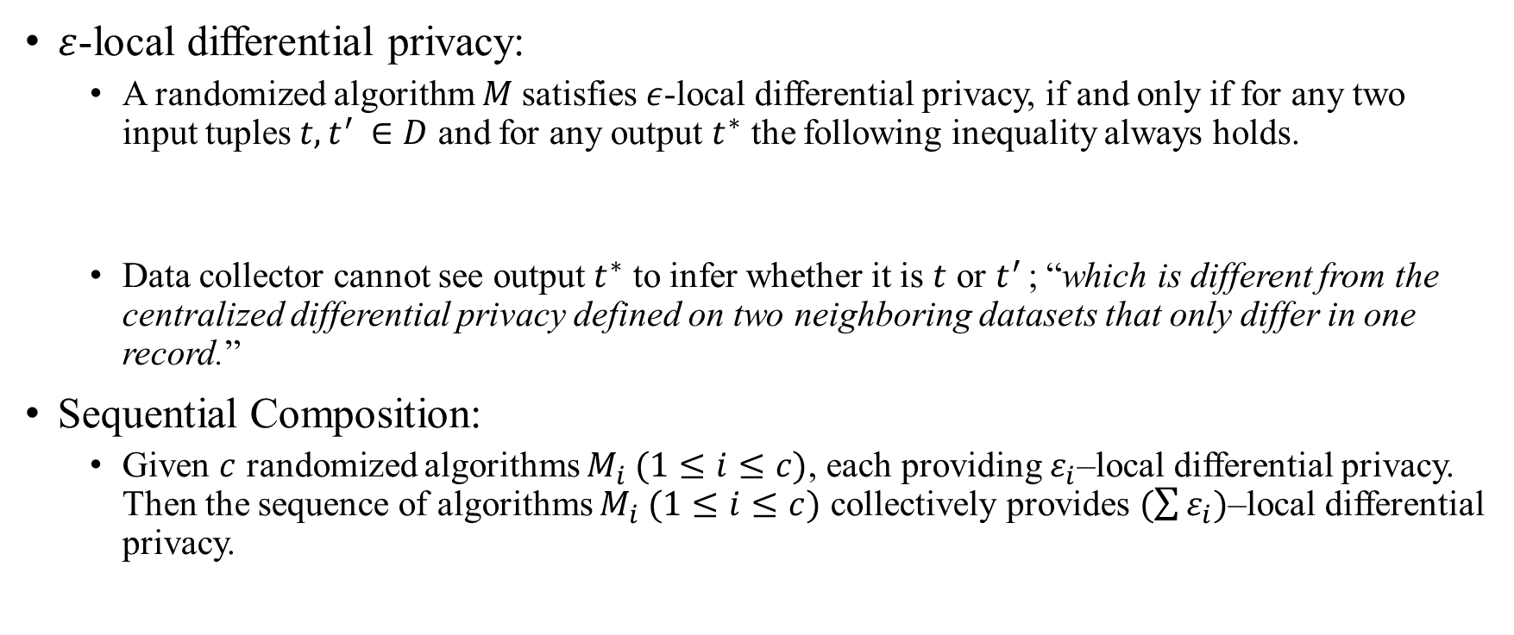
Basic Concepts
$ε$-local differential privacy:
A randomized algorithm $M$satisfies $ε$-local differential privacy, if and only if for any two input tuples $t, t^{′ }∈D$ and for any output $t^{∗}$ the following inequality always holds.
Data collector cannot see output $t^{∗}$ to infer whether it is $t$ or $t^{′ }$; “which is different from the centralized differential privacy defined on two neighboring datasets that only differ in one record.”
Sequential Composition:
Given $c$ randomized algorithms $M_{i} (1≤i≤c)$, each providing $ε_{i}$–local differential privacy. Then the sequence of algorithms $M_{i} (1≤i≤c)$ collectively provides $(\sum{ε_{i})}$–local differential privacy.
$$\operatorname{Pr}\left[M\left(t\right)=t^{∗}\right]≤e^{ε}×\operatorname{Pr}\left[M\left(t^{′}\right)=t^{∗}\right]$$

Slide 7
Laplace SUXXXX
Ngyuen et al.

Slide 8
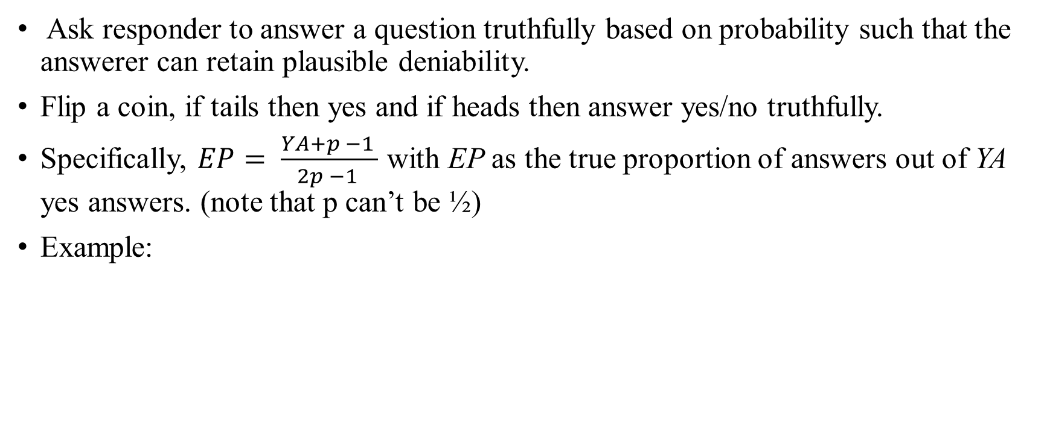
Randomized Response
Ask responder to answer a question truthfully based on probability such that the answerer can retain plausible deniability.
Flip a coin, if tails then yes and if heads then answer yes/no truthfully.
Specifically, $EP= \frac{YA+p −1 }{2p −1 }$ with EP as the true proportion of answers out of YA yes answers. (note that p can’t be ½)
Example:
Concept Understanding Question (p=½)
500 responses, probability ½ to answer.
So 250 answered the question and 250 didn’t.
479 Yes – 250 = 229/250 = .916 = 91.6%
21 No / 250 = .084 = 8.4 %
Notes:
YA = (p* EP) + (1-p)(1-EP)
NA = (1 – EP)p + EP(1-p)
Don’t get too caught up in the math, just know the basic concept.

Slide 9



Randomized Response
To modify RR for $ε$-local differential privacy, we change p probability to be:
And the data collector will need f “true” answers:
$$p= \frac{e^{ε}}{1+e^{ε}}$$
$$f^{′}= \frac{p −1+f}{2p −1 }$$

Slide 10
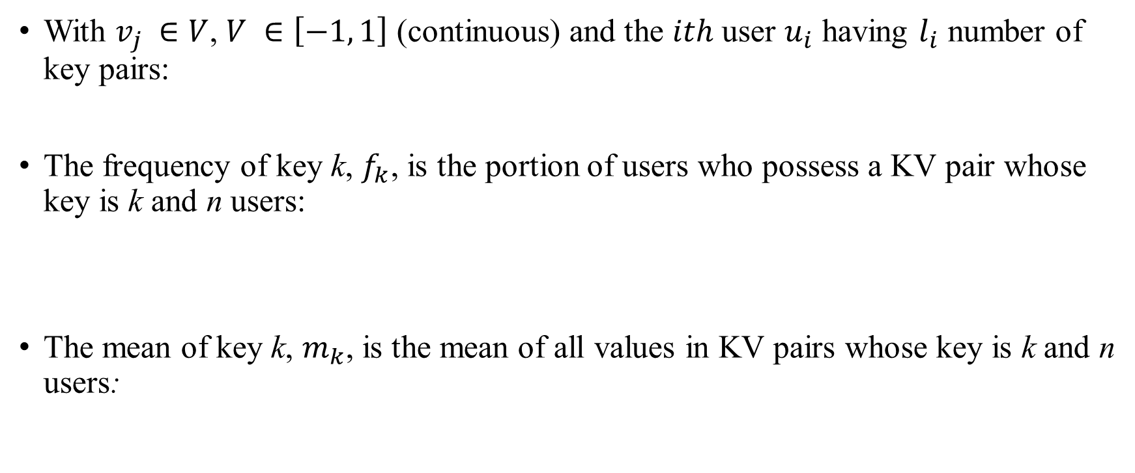


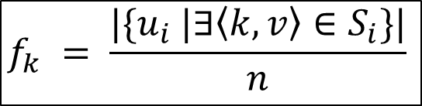
Definition of Key-Value Protocol
With $v_{j} ∈V$, $V ∈\left[−1, 1\right]$ (continuous) and the $ith$ user $u_{i}$ having $l_{i}$ number of key pairs:
The frequency of key k, $f_{k}$, is the portion of users who possess a KV pair whose key is k and n users:
The mean of key k, $m_{k}$, is the mean of all values in KV pairs whose key is k and n users:
$$S_{i}=\left\{\left\langle k_{j}, v_{j}\right\rangle \right| 1≤j≤l_{i}\}$$
$$f_{k} = \frac{|\{u_{i} |∃\left\langle k, v\right\rangle ∈S_{i}\}|}{n}$$
$$m_{k}= \frac{Σ_{i}Σ_{j:k_{j}=k_{ }^{v_{j}}}}{n ∗ f_{k} }$$
Notes:
Si is the set of KV pairs that user ui has.
Frequency is for each user they have a key in Si divided by n number of users.
Mean is the sum of all values that are all the same k that are owned by users n.

Slide 11
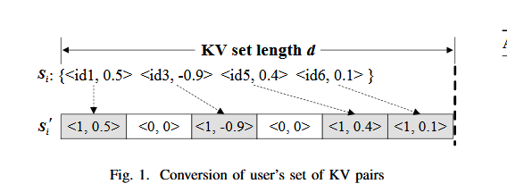
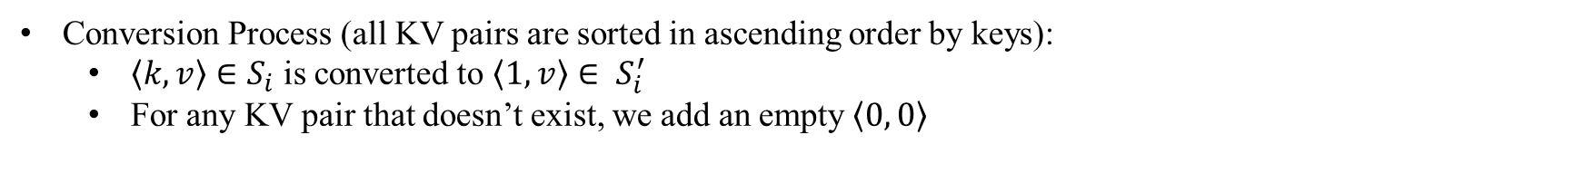
Flawed Key-Value Perturbation Protocol
Conversion Process (all KV pairs are sorted in ascending order by keys):
$\left\langle k, v\right\rangle ∈S_{i}$ is converted to $\left\langle 1, v\right\rangle ∈ S_{i}^{′}$
For any KV pair that doesn’t exist, we add an empty $\left\langle 0, 0\right\rangle$
Notes:
NOTE: Be sure to point out the ids are sequential and sorted.
For <0,0> you basically add a value that DNE. Like here there is a skip between .5 and -.9 for id1 and id3 so we add a single <0,0> pair.

Slide 12
Flawed Key-Value Perturbation Protocol
Now all keys are either 0 or 1 (binary). By a certain probability, we change flip the key to its opposite so that the data collector cannot predict a user has had a KV pair.
The values are changed as follows:
If key is 1, then don’t change value.
If key is 0, then don’t change value.
If key went from 1 to 0, then set value to 0 since key is empty and missing. (Mean estimation preserved)
If key went from 0 to 1, then randomly set key a value between [-1, 1] in the continuous domain.

Slide 13
Flawed Key-Value Perturbation Protocol
The last step introduces a flaw since a random value is assigned (0 to 1).
Data collector will be able to guess a true value given many values with high confidence.
Especially in the case that the true values deviate from the uniform randomness of [-1,1].
A uniform distribution also allows for a mean of 0–affecting the mean estimation for that key.
To fix, we perturb a value regardless whether it is real or assigned value in the conversion process.
Notes:
NOTE: Last step isn’t shown in the picture.
True values like if we see .4 or 1.2323 and then the next value after conversion is <1,.2> like hmmm that might be false.
If all true value mean = 0 or true mean = perturbed mean and all uniform perturbed keys are 0 or perturbed keys = - true mean then 0 mean. Total info loss.

Slide 14
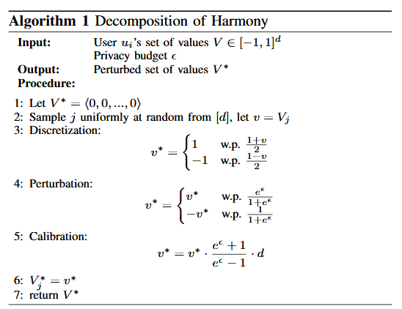
Proper Perturbation
Mainly relies on Harmony
[31] T. T. Nguyˆen, X. Xiao, Y. Yang, S. C. Hui, H. Shin, and J. Shin. Collecting and analyzing data from smart device users with local differential privacy. arXiv:1606.05053, 2016
Converts numerical values in KV pairs to binary and perturb with RR.
Values will be [-1,1] (continuous); d is the set of natural numbers {0, 1, 2…}
However, mean will be biased, so we will need to calculate the bias (done at data collector side).
Notes:
- “Each perturbed value in Harmony is simply scaled d times to counterbalance the effect of sampling, which may
also cause bias.”

Slide 15
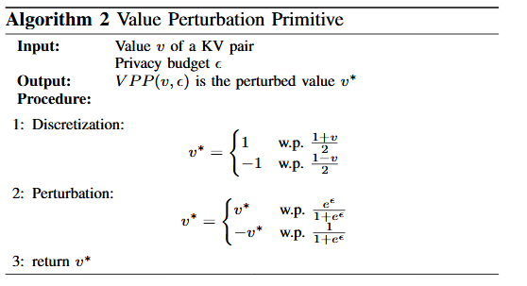
Value Perturbation Primitive
Notes:
3 changes:
Calibration step is given to data collector

